Slide 1
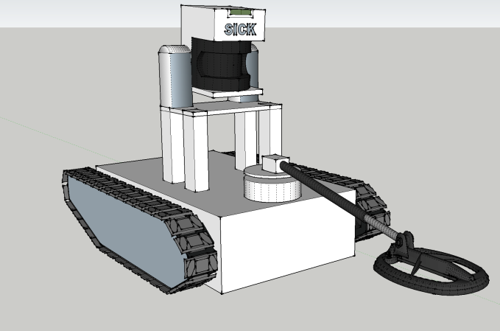
UGV* Mine Detector
Josh Genao EE/CpE
Ronald Hanifen CpE
Hernan Carvajal EE
Javier Palomo EE
Group 11
*UGV = Unmanned Ground Vehicle Sponsored By EZ Claims, Inc.

Slide 2
Motivation
Landmines kill 15 to 20 thousand people every year (mostly children), and many countless more off record.
At the current rate of clearing land mines it will take humans thousands of years to clear all the active land mines in the world.
The current methodology of removing/deactivating land mines is extremely dangerous.
We aim to solve this by creating a robot that will handle this detection, locate these mines, and determine a clear path from start to destination

Slide 3
Project Goals
Semi-Autonomous Vehicle
  Robot Operating System Integration
  Obstacle Avoidance
    LIDAR
    Odometry
  Metal Detection
  Wireless Communication
  Power Control
  Motor Control

Slide 4
Specifications
Feature | Measurement
Dimension | 11”x12” + 12” for Metal Detector
Operating Range | 100 ft
Power Supply Voltage | 2x(14.8V 5000 mAh LiPo)
Maximum Payload | 20 kg
Maximum Speed | 0.3 m/s
Battery Life | 1 hr (max current draw)
Recharge Time | < 3 hrs

Slide 5
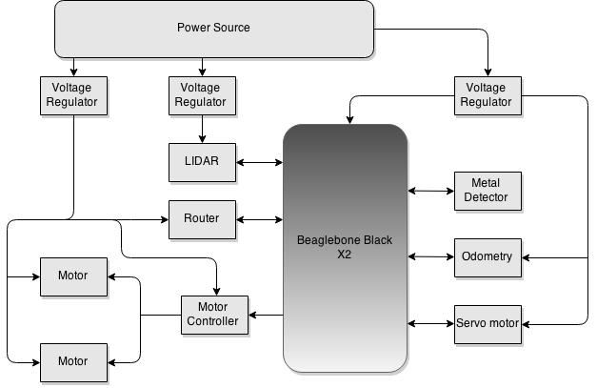
Hardware Block Diagram

Slide 6
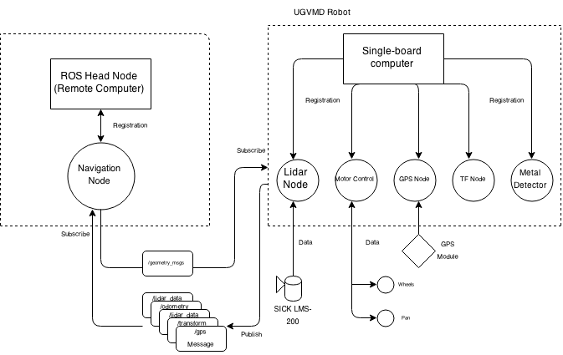
Software Block Diagram

Slide 7
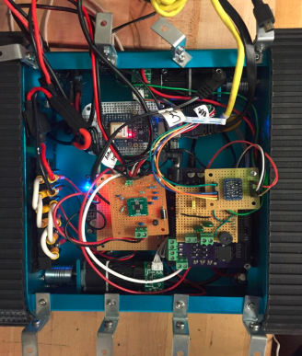
Overall System
ROS
Pathfinding
Power Systems
Metal Detection
Obstacle Avoidance

Slide 8



ROS
Robot Operative System
Collection of open-source software frameworks for robot software development
Allows for easier hardware abstraction and code reuse
Project uses ROS Indigo

Slide 9
How ROS works
Comprised of multiple independent nodes communicating with each other
Uses a publisher/subscriber messaging model

Slide 10
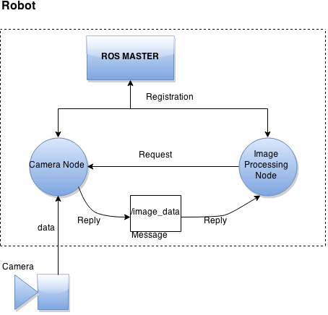
How ROS works - Example

Slide 11
How ROS works
Comprised of multiple independent nodes communicating with each other
Uses a publisher/subscriber messaging model
All nodes are registered through a Master Node
  Allows all other ROS nodes to find each other
Transporting message data uses standard TCP/IP sockets
  Also supports UDP-based message transport

Slide 12
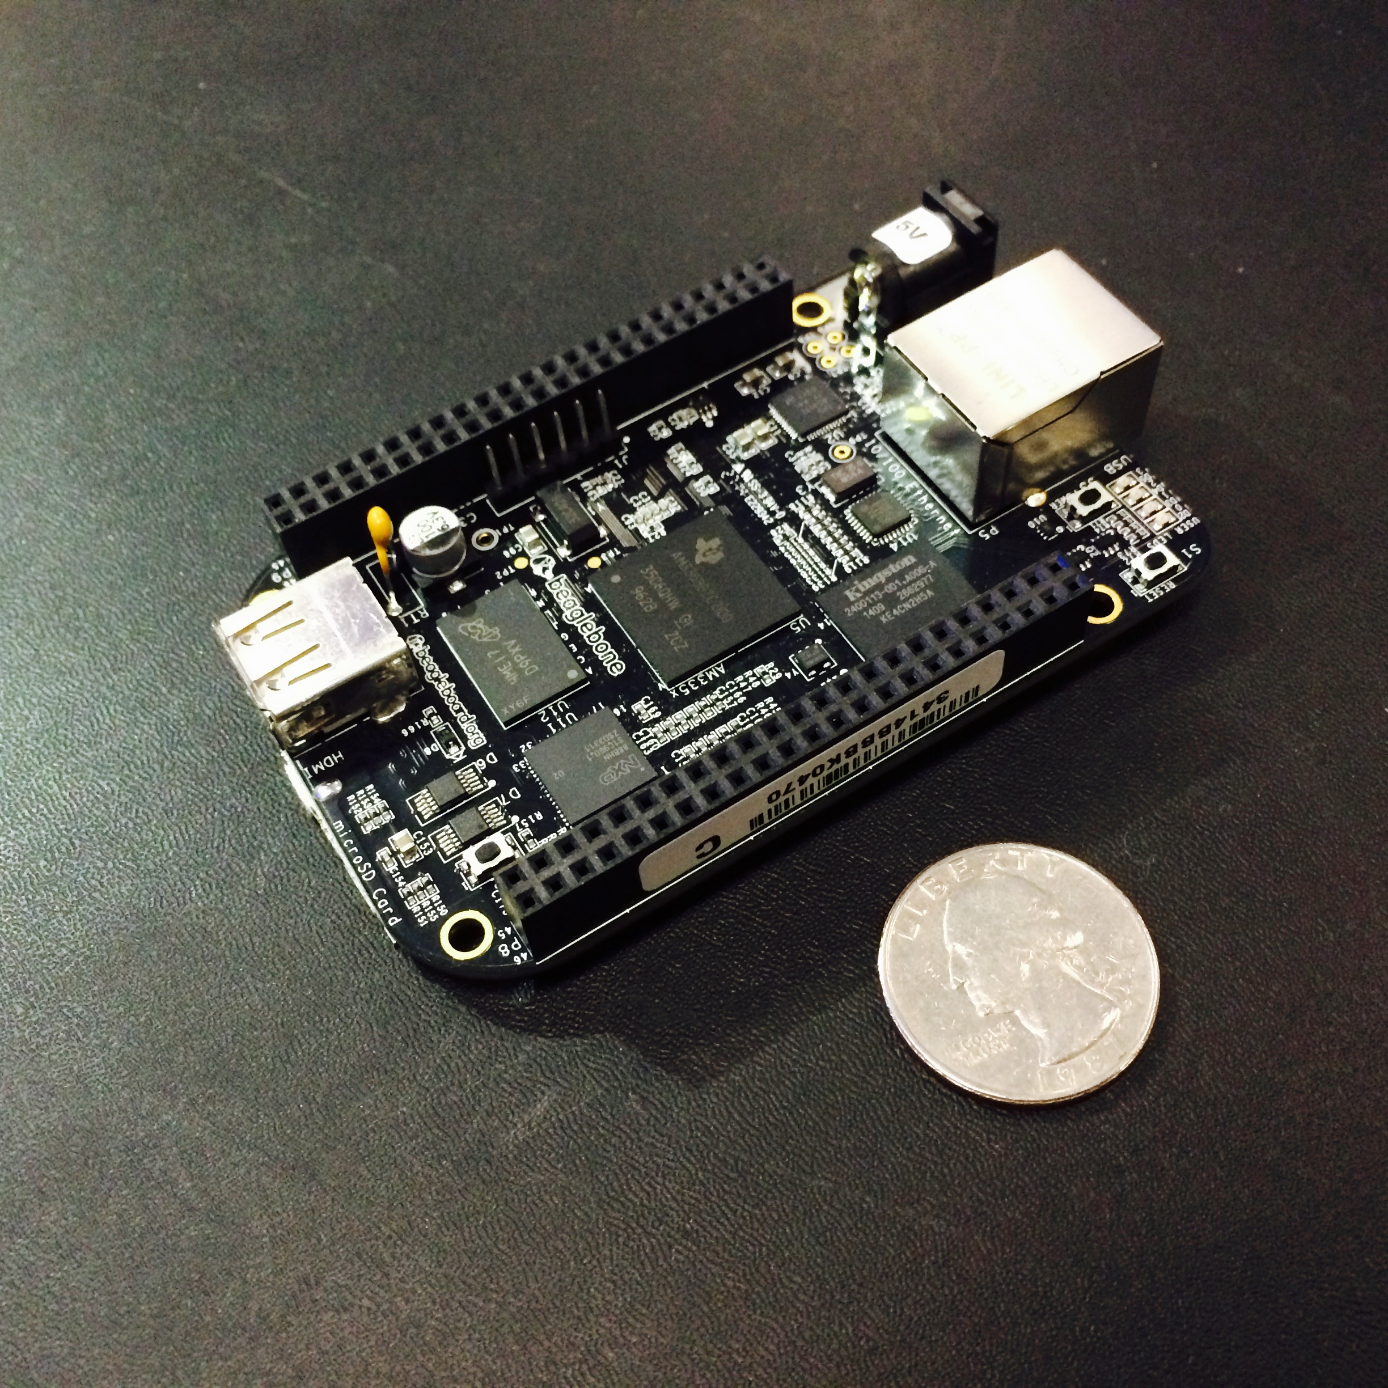
BeagleBone Black
Used to send data to MCU
Receives information from MCU to act according to surrounding conditions
Peripherals:
  LIDAR
  IMU
  Motor Controls
  Metal Detector

Slide 13
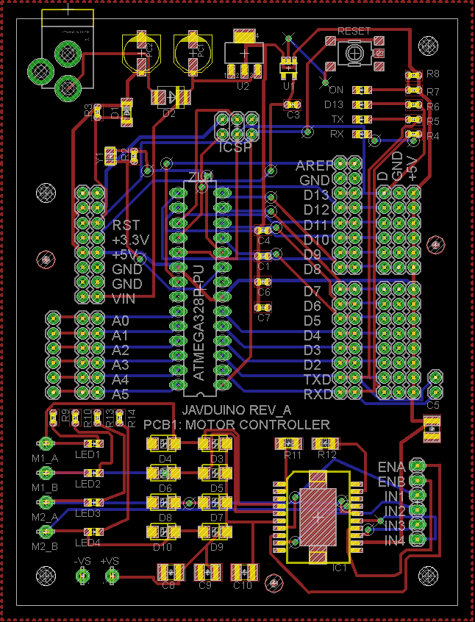
Motor Controller
Atmel ATmega328
  Control H-Bridge and Servo
  Flash 32Kbytes
  16 MHz ceramic resonator
Serial Peripheral Interface
  ICSP header
L298 Dual Full-Bridge Driver
  Dual bidirectional DC motor controller

Slide 14
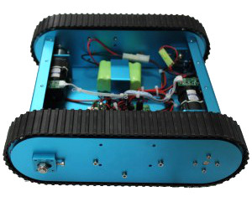
Platform
Tracked Mobile Tank Kit
  Dimensions:
    L-320mm, W-300mm, H-110mm
  Weight:
    4.3Kg
  Maximum Load:
    20Kg
  Materials:
    Aluminum alloy chassis
    Rubber Tracks

Slide 15
Platform
Advantages
Disadvantages
Stable
Light weight
Traction
Mobility
Easy to Modify
Made of Aluminum alloy
  Small EMF interference
  Coil placement
Expensive
Tank treads not readily available

Slide 16
DC Motors
Faulhaber 12V DC Motor
  Operating Voltage/Current: 12VDC/ 1.4A
  RPM: 8100
  Gearbox Ratio: 64:1
  Stall Torque: 11.3 oz-in
  Diameter: 30mm, Diameter of Shaft: 6mm
  Length: 42mm, Length of Shaft: 35mm
  Total Length: 85mm

Slide 17
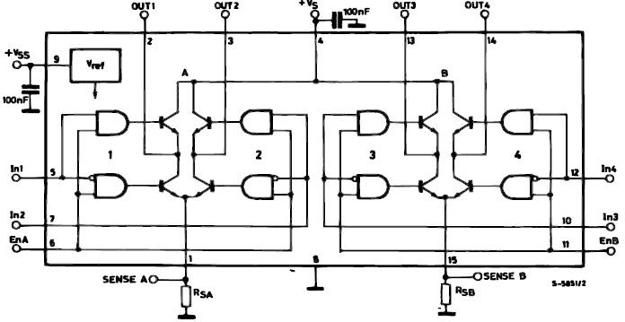
L298P/N Dual Full Bridge Driver

Slide 18
H-bridge
Inputs |  | Operation
Venable = H | A = H & B = L | Forward
 | A = L & B = H | Reverse
 | A=B | Stop
Venable = L | A = X & B=X | Free Run Stop
ST L298P Dual Full-Bridge Driver
  Number of H-Bridges = 2
  Logic Supply Voltage = 4.5V to 7V
  Power Supply Voltage = 4.8V to 46V
  Max Output Current = 2A per channel
  Output Control = PWM
  Requires external Schottky Diodes

Slide 19

Power System
Integrated Power Supply
  2 x (14.8V 5000mAh LiPo) = 14.8V 10,000mAh LiPo
    Tenergy TB6-B 50W balancing charger
  Voltage Regulation
    TPS61175 14.8V 3A Switching Regulator
    LM25088 12V Switching Regulator
    TPS54526 5V 5.5A Switching Regulator

Slide 20
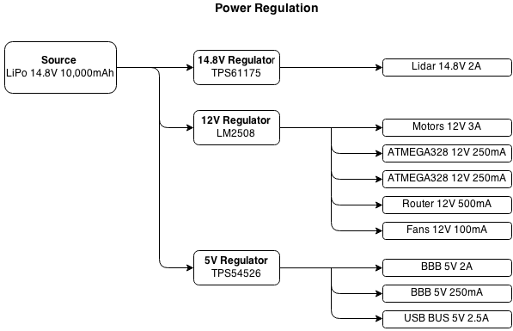
Power System

Slide 21
Power System Requirements
Component | Vout | Iout(max)
LIDAR | 14.8V | 2.0A
Motor Controller | 12V | 3.0A
ATMega328_1 | 12V | 250mA
ATMega328_2 | 12V | 250mA
Router | 12V | 500mA
Fans (X2) | 12V | 100mA
Beagle Bone Black | 5V | 2.0A
Beagle Bone Black | 5V | 250mA
USB Bus | 5V | 2.5A
Max Current Draw |  | 10.85 A

Slide 22
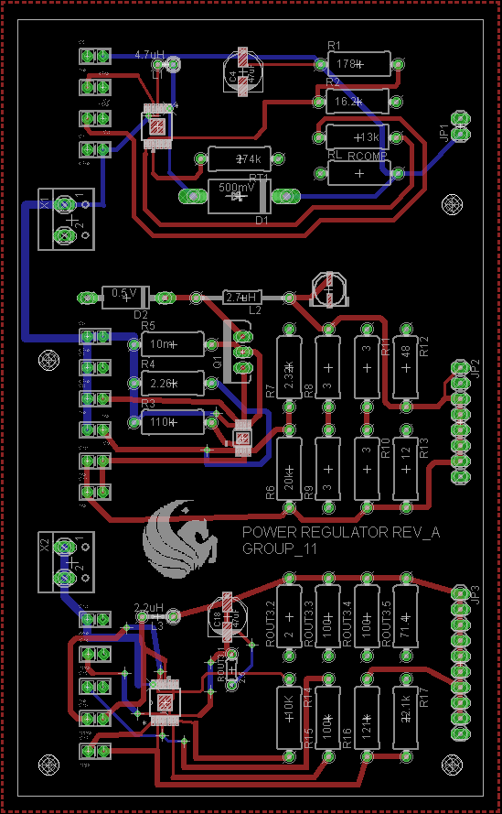
Power Regulation Layout

Slide 23
Detection System
Types of Detection
  Ground Penetrating Radar (GPR)
  Infrared Red (IR) Imaging
  Ultrasound
  Metal Detector
    Frequency counter
    Single coil
    Brief magnetic field
    Eddy current
    Circuit
    No need of data analysis

Slide 24
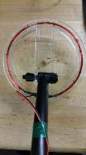
Detection System
Design
  Circuit
    Pulse Generation
    Receiver
      Counter set
    Output generator
    Communication with BeagleBone
  Coils
    Build Coil
      6 inch diameter
      26 gauge copper wire, 30 turns
      ¼ in. acrylic sheets

Slide 25
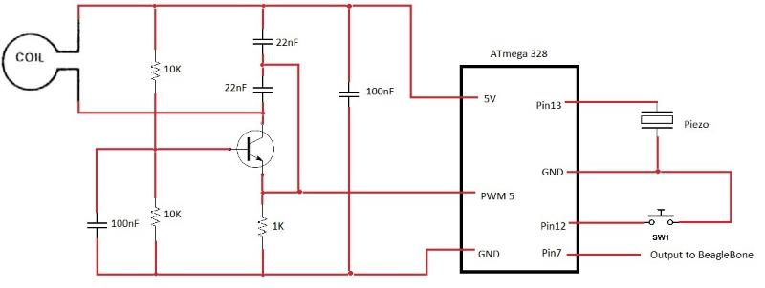
Circuit

Slide 26
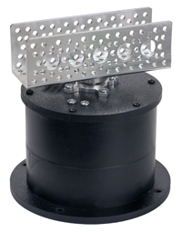
Pan System
Hitec DDP155H Base Pan
  Fits multiple size servos
Pololu High-Torque servo 1501MG
  Operating voltage: 4.8 - 6.0 Volts
  Stall Torque: 15.5 - 17 Kg-cm
  180 degrees operating angle
  Weight: 60g
Optimal detection sweeping speed: 0.12m/s – 1.0m/s
  Actual detecting speed: 0.18m/s

Slide 27
Metal Detector Testing
Detection Test
  Steady
  Sweeping

Slide 28
Main Control Unit
ROS Master Node
Processes the information received from the robot
Display laser scan mapping
Display location of robot and IEDs

Slide 29


Operating System
BeagleBone: UbuntuARM Trusty 14.04 LTS
  Able to implement ROS
  Large community
  Currently booting from microSD
MCU: Ubuntu 14.04 LTS

Slide 30
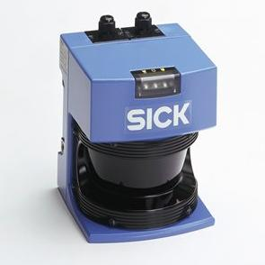
SICK LMS-200 Laser Measurement Sensor
Model Name | LMS 200-30106
Field of view: | 180°
Angular resolution: | 1, … 0.25°
Scanning Range: | 80 m
Statistical Error: | 5 mm
Data interface: | RS-232, RS-422
Supply voltage: | 24 V DC +/- 15%
Dimensions (LxWxH) | 156 x 155 x 210 mm

Slide 31
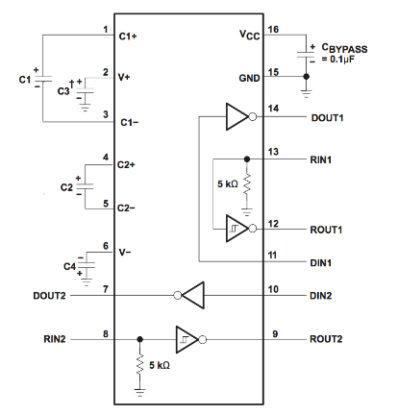
RS232 Connection
Texas Instruments MAX3232
RS-232 to USB converter
BeagleBone UART communication needs 3.3V
Vcc = 3.3v
Rout = ± 0.3Vcc

Slide 32
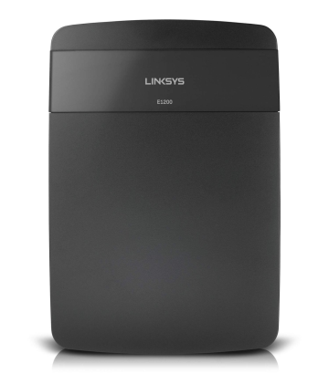
Wireless Communication
LINKSYS E1200
Wireless Router
Wireless mode 802.11 b/bgn or 802.11n
2.4 GHz wireless connection
Used as access point
BeagleBone connected via ethernet
BeagleBone has a static IP address

Slide 33
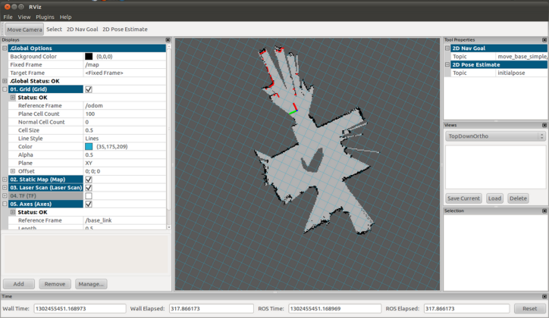
MCU Interface - RVIZ

Slide 34
Pathfinding
  A* algorithm ROS node
    Primarily uses GPS information to determine clear path
  Waypoints
    Determine safe zones based on known locations of mines
    Plays into A* algorithm to help determine clear path
  Clear Path
    Robot will determine the clear path based on locations traveled, and known destination

Slide 35
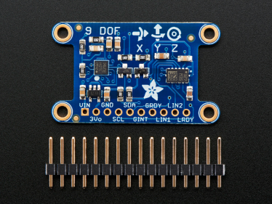
IMU
I2C communication
3.3V or 5V logic boards
9 axes of data
  3 axes of accelerometer data
  3 axes of gyroscopic data
  3 axes of magnetic data

Slide 36
Obstacle Avoidance
  Navigation Stack
    LIDAR
      Point cloud information to detect immediate threat obstacles
    Move Base
      Local and global planners that determine a path based on a positional goal.
    Base Controller
      Motor Controls

Slide 37
Issues
Power Regulation PCB
  Expensive printing cost due to heavy copper wieght
  Solution: mount components on perf board
ROS
  GMapping
Configuration issues with LIDAR
  Was set to RS422 instead of RS232
Platform mechanical
Magnetic coils

Slide 38
Bill of Materials
Product # | Product Name | Description | Number of Units | Unit Price | Estimated Total Price | Actual Price
RB-Nex-34 | Tracked Mobile Tank | Platform | 1.00 | $719.97 | $719.97 | $683.97
L298P | STM Dual Full-Bridge Driver | H-Bridge | 2.00 | $4.67 | $9.34 | $9.34
ATmeg16U2 | Low power 8-bit RISC MCU | USB-to-Serial Converter | 0.00 | $4.39 | $0.00 | $0.00
ATmeg328 | 32kB 8 Bit MCU | Micro Controller | 1.00 | $3.51 | $3.51 | $3.51
15019 | Venom 25C 4S 5000mAh 14.8 LiPO | LiPo Battery | 2.00 | $72.67 | $145.34 | $145.34
B00466L0BW | Tenergy TB-6 50W Balancing Charger | Battery Charger | 1.00 | $45.99 | $45.99 | $0.00
1996 | Element-14 Beagle Bone Black | Rev-C | 2.00 | $55.00 | $110.00 | $110.00
746 | Ada Fruit Ultimate GPS | Breakout-66 Channel with 10Hz Update | 1.00 | $35.95 | $35.95 | $35.95
1015850 | SICK LMS 200 | Lidar Detection System | 1.00 | $399.99 | $399.99 | $399.99
TPS54526PWP | Synchronous Step-Down SWIFT | Switching Regulator | 2.00 | $3.05 | $6.10 | $6.10
TPS61175PWPR | High Voltage Boost Converter | Switching Regulator | 2.00 | $4.02 | $8.04 | $8.04
LM25088MH-2 | Non-Synchronous Buck Converter | Switching Regulator | 2.00 | $3.75 | $7.50 | $7.50
WNR1000 | Linksys E1200 Wireless Router | Router | 1.00 | $30.00 | $30.00 | $30.00
1714 | Ada Fruit 9-DOF IMU | Inertial Measurement Unit | 1.00 | $19.95 | $19.95 | $19.95
 | OSH Park | PCB Printing | 1.00 | $59.80 | $59.80 | $59.80
 |  | Total Cost |  |  |  | $1,519.49

Slide 39
Work Load Spread
Task | Ron | Josh | Hernan | Javier
Power Regulation |  |  | X | X
Motor Controller |  |  |  | X
Metal Detection |  |  | X
Platform |  |  | X | X
LIDAR |  | X
ROS Development | X | X
MCU Implementation | X | X
Path finding | X

Slide 40
Questions?

